Slide 1
Photo Studio Operations — Release 1
Requirements → Design → Prototype
Manana Bebia, Anna Sulkhanishvili, Dan Cebanu, Nikita Springis

Slide 2
Problem Statement & Project Scope
Problem: The photo studio currently relies on manual processes (orders, payments, consumables, reports). Errors and inefficiencies occur.
Scope (Release-1):
Register client orders (photo printing, film developing)
Handle express surcharge (+25%)
Issue two forms (client & photographer)
Pass orders to photographer & track processing
Payment on completion
End-of-day reports: revenue (Receptionist), materials (Photographer)
Out of scope: multi-branch, online payments, predictive stock

Slide 3
User Stories & Acceptance Criteria
US1 - As a Client, I want to place an order so that I can get my photos printed or film developed.
US2 — As a Receptionist, I want to record client details (surname) and desired completion time when taking an order so that the order is accurately registered
US3 — As a Receptionist, I want to mark an order as completed and record payment so that the order lifecycle is correctly updated and revenue is accounted for.
US4 — As a Photographer, I want to report the consumables (paper, developer, etc.) used for my tasks so that stock levels can be accurately tracked.
US5 - As a Studio Administrator, I want to manage consumables stock levels so that I can ensure the studio is always supplied.
US6 - As a Studio Administrator, I want to review reports on consumed materials so that I can make informed purchasing decisions.

Slide 4
CRC Cards Overview
Class: Receptionist (inherits Employee)
Responsibilities | Collaborators
Register new client orders Pass orders to the photographer Generate revenue report | Client Order Photographer Report
Class: Photographer (inherits Employee)
Responsibilities | Collaborators
Process orders Track consumables used Generate material usage report | Order ConsumableUsage Administrator Receptionist
Class: Employee (abstract / parent)
Responsibility | Collaborators
Represent shared attributes of employees (name, ID) Define base responsibilities for staff roles | Receptionist Photograpgher Administrator
Class: Report
Responsibility | Collaborators
Represent reports Store report content and allow output/printing | Receptionist Photographer Administrator

Slide 5
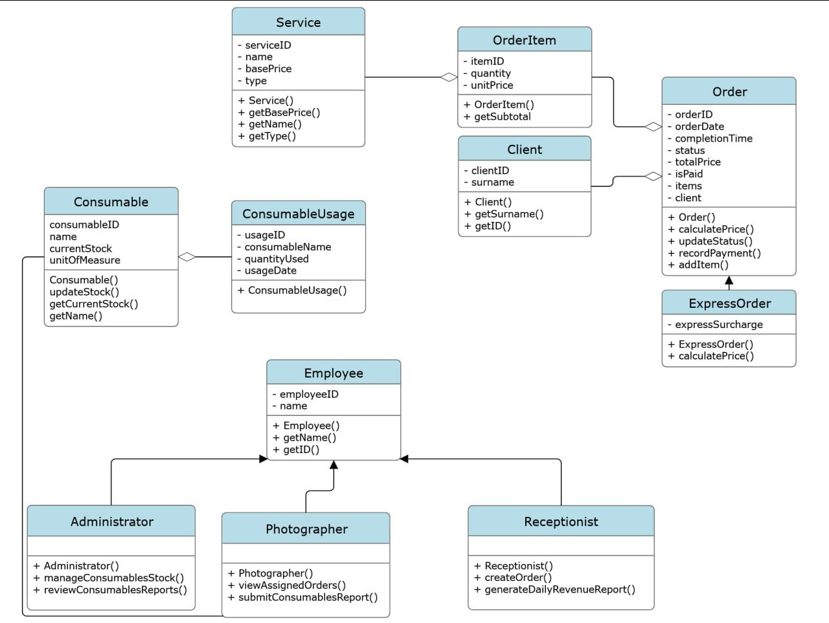
Conceptual Simple Class Diagram

Slide 6
Traceability table
User Story | CRC Responsibility | Simple Class Diagram Element | C++ Element
As a Client, I want to place an order so that I can get my photos printed or film developed. | Client: provide surname and order details, place orders | Client - Order- Receptionist | Class: Client Receptionist::createOrder()
As a Receptionist, I want to specify if an order is "express" so that the correct surcharge is applied. | ExpressOrder: apply surcharge | ExpressOrder (inherits Order) | ExpressOrder::calculatePrice()

Slide 7
Team Roles
Nikita | Run the prototype, test different scenarios (urgent orders, multiple clients, etc.).. Ensure project deliverables are formatted and complete.
Dan | Implement the C++ prototype (classes, methods, and basic scenario in main()). Ensure the prototype reflects the CRC and UML design. Add comments in the code for clarity
Anna | Create CRC cards. Draw the UML class diagram (with inheritance from ReportGenerator). Ensure responsibilities are properly distributed between classes.
Manana | Write the SRS (purpose, scope, user stories, requirements). Define functional and non-functional requirements. Help with the traceability table.

Slide 8
Lessons Learned
Object-oriented programming principles
Role of CRC cards in design
Transition from concept to technical implementation
Importance of requirements analysis

